Slide 1
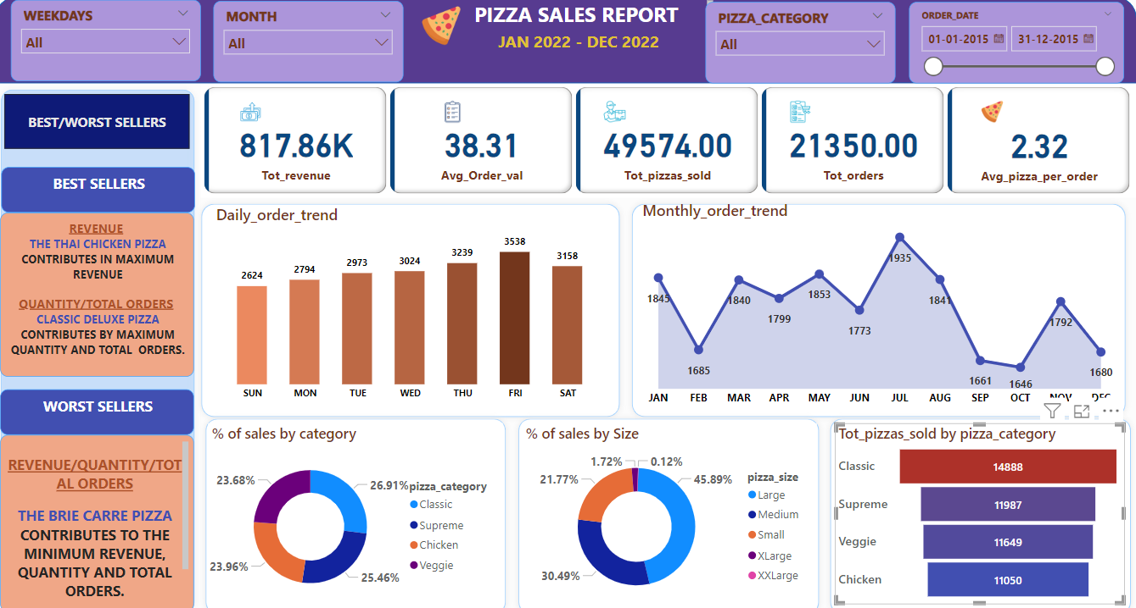
PROBLEM STATEMENT
KPI’S Requirement
Analyse key indicators for pizza sales data to gain insights into business performance. Specifically measuring following metrics:
Total Revenue:
Total revenue generated, sum of sales amount of all pizzas.
2. Average Order Value:
Average amount spent per order, calculated by total revenue w.r.t total number of orders.
3. Total Pizzas Sold
Total quantity of pizzas sold.
4. Total Orders:
Total number of orders placed.
5. Average pizzas per order:
Total quantity of pizzas w.r.t total orders placed.

Slide 2
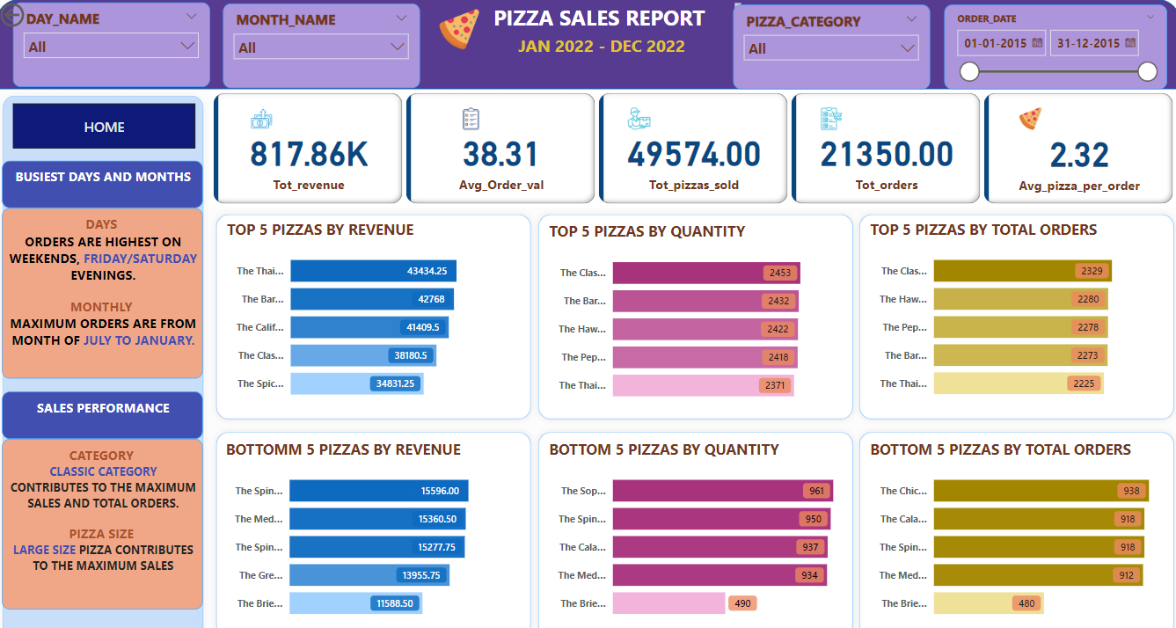

Charts Requirement
As per client requirement, we have to identify following trends in our PowerBI report.
Daily trend for total orders:
To analyze the trend of daily orders for each weekday. We will use bar chart for this visualization. This will help
us to see max orders on any particular weekday or weekend.
2. Monthly trend for total orders:
In similar way, we will calculate orders trend for each month of the year. We will use line chart to see order
pattern for the year on monthly basis. It will help us to identify a particular month in which max or min order
were placed.
3. Percentage of sales by pizza category:
Pie or donut chart in this case will give us insight about contribution of each category of pizza in total revenue
generated.
4. Percentage of sales by pizza size:
Again using pie or donut chart to get insight about contribution of pizzas by their size in total revenue.
5. Total pizzas sold for each category:
Using funnel chart to represent the total number of pizzas sold for each pizza category to see which category is
highest selling in quantity.

Slide 3
Charts Requirement
6. Top 5 best sellers by total revenue, quantity and no of orders:
Creating a column chart to represent the top 5 best sellers pizzas, by revenue, quantity and total
orders.
7. Bottom 5/worst sellers by total revenue, quantity and no of orders:
Creating a column chart to represent the bottom 5 pizzas, by revenue, quantity and total
orders.

